Slide 1


Real-time knowledge acquisition(College ERP system)
Sravani Pati
Pragathi pendem

Slide 2
Introduction
Eliminating poverty in education is the key problem we'll be tackling.
We want to create a language-learning tool for users that will be available online. Through this software , users can communicate with teaching assistants online and get their questions answered.
This program also helps students learn new things, connect with plenty of people who share their interests, and access a variety of resources so they may learn more rather than just focusing on one thing.
The goal of the college information management system is to give administrators of any organization the capacity to amend and out a student's personal information while enabling the student to maintain his professional development.
Notes:
Editorial Guidelines on Bullets:
1. Vertical lists are best introduced by a grammatically complete sentence followed by a colon. No periods
are required at the end of entries unless at least one entry is a complete sentence, in which case a period
is necessary at the end of each entry.
Example: A university can be judged by three measures:
· The quality of its students
· The quality of it faculty
· The quality of its infrastructure
2. If a list completes the sentence that introduces it, items begin with lowercase letters, commas or semicolons
(if individual items contain commas) are used to separate each item, and the last item ends with a period.
Note that the introductory clause does not end with a colon.
Example: A university can be judged by
· the quality of its students,
· the quality of its faculty,
· the quality of its infrastructure.
3. Avoid mixing sentence and nonsentence items in a bulleted list.
2

Slide 3
Time schedule
The Project schedule activities will consist of following:
Forming The Team
2. Selecting The Project Title
3. System Requirement Collection
4. System Design
5. Acquiring the required resources
6. Coding
7. Testing of the Application
8. Deployment
Notes:
Editorial Guidelines on Bullets:
1. Vertical lists are best introduced by a grammatically complete sentence followed by a colon. No periods
are required at the end of entries unless at least one entry is a complete sentence, in which case a period
is necessary at the end of each entry.
Example: A university can be judged by three measures:
· The quality of its students
· The quality of it faculty
· The quality of its infrastructure
2. If a list completes the sentence that introduces it, items begin with lowercase letters, commas or semicolons
(if individual items contain commas) are used to separate each item, and the last item ends with a period.
Note that the introductory clause does not end with a colon.
Example: A university can be judged by
· the quality of its students,
· the quality of its faculty,
· the quality of its infrastructure.
3. Avoid mixing sentence and nonsentence items in a bulleted list.
3

Slide 4
Identification of stake holders
Teachers
Students
Administrator
View points
Teachers viewpoint
Students viewpoint
Administrator viewpoint

Slide 5
The operating environment for our system are listed below:
Operating System: Windows10
Database: My SQL database
Frontend: HTML/CSS/Bootstrap
Backend: Django
Hardware Interfaces
Since neither the mobile application nor the web portal have any designated hardware, It does not have any direct hardware interfaces .Any browser can be used to access the web app.
Software Interfaces
Operating System: We have chosen Windows operating system for its best support and user-friendliness.
Django : We have chosen to use Django for the back-end of the website as Django is a simple python framework and is suitable for beginners. Database : We are using SQ Lite database, which comes as default with Django.

Slide 6
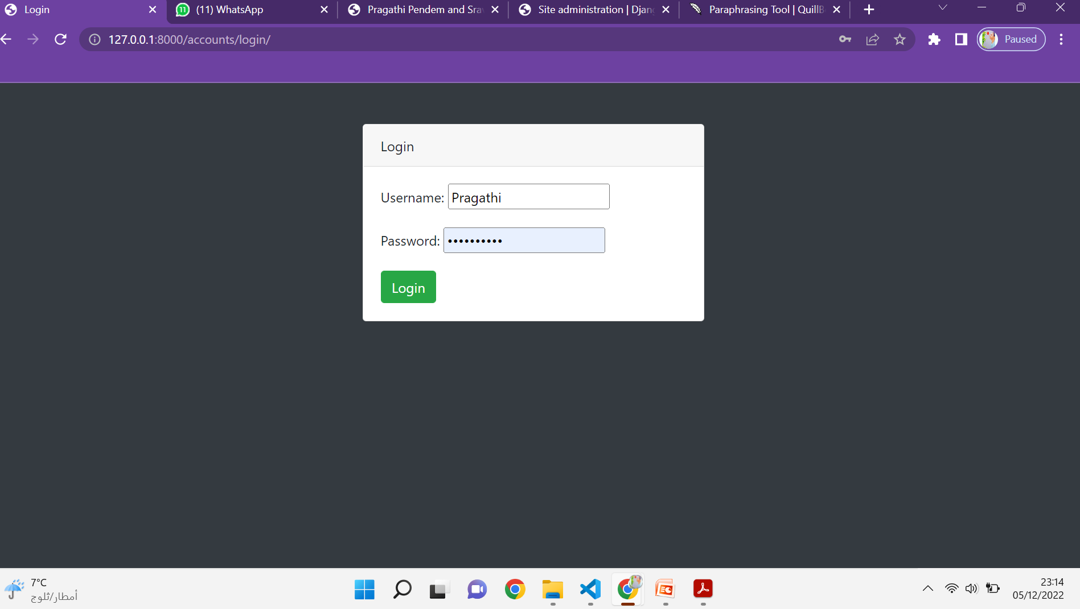
System Implementation
Student login page

Slide 7
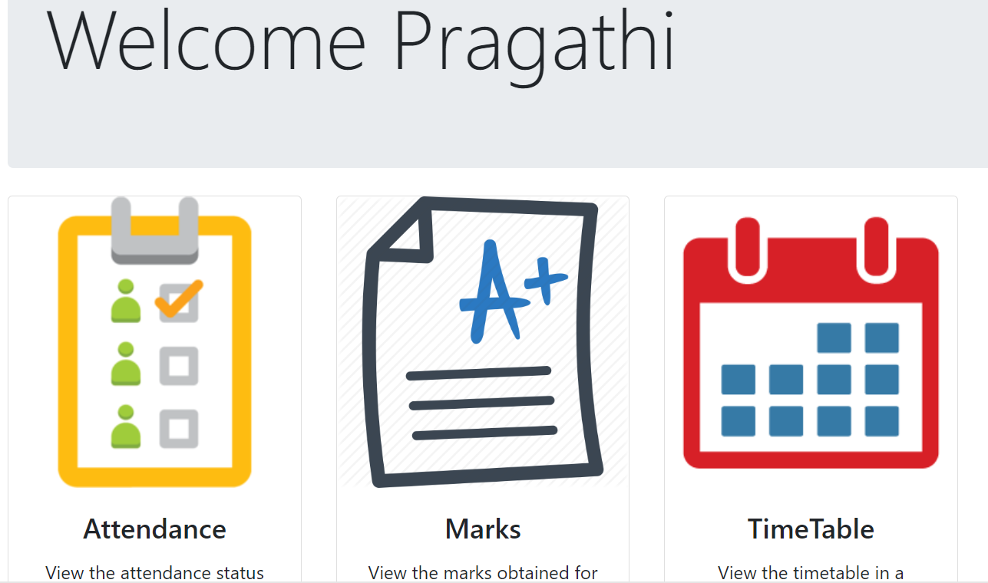
Homepage

Slide 8
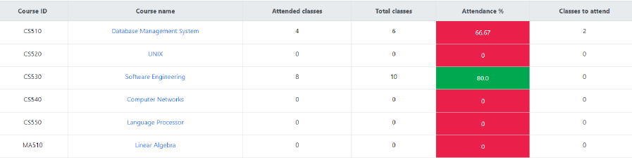
Attendance

Slide 9
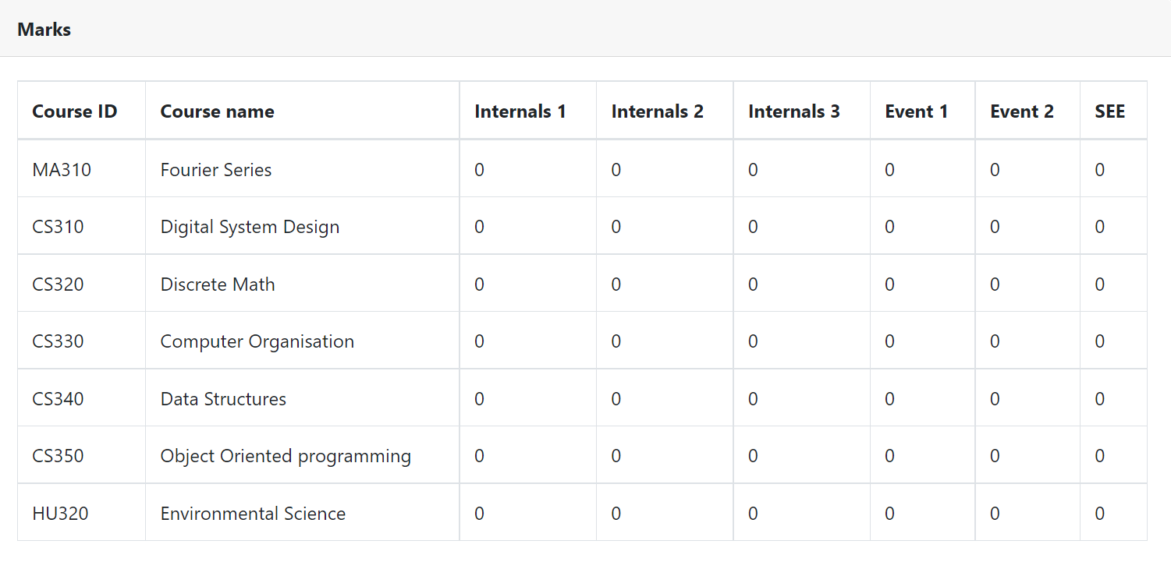
Marks

Slide 10
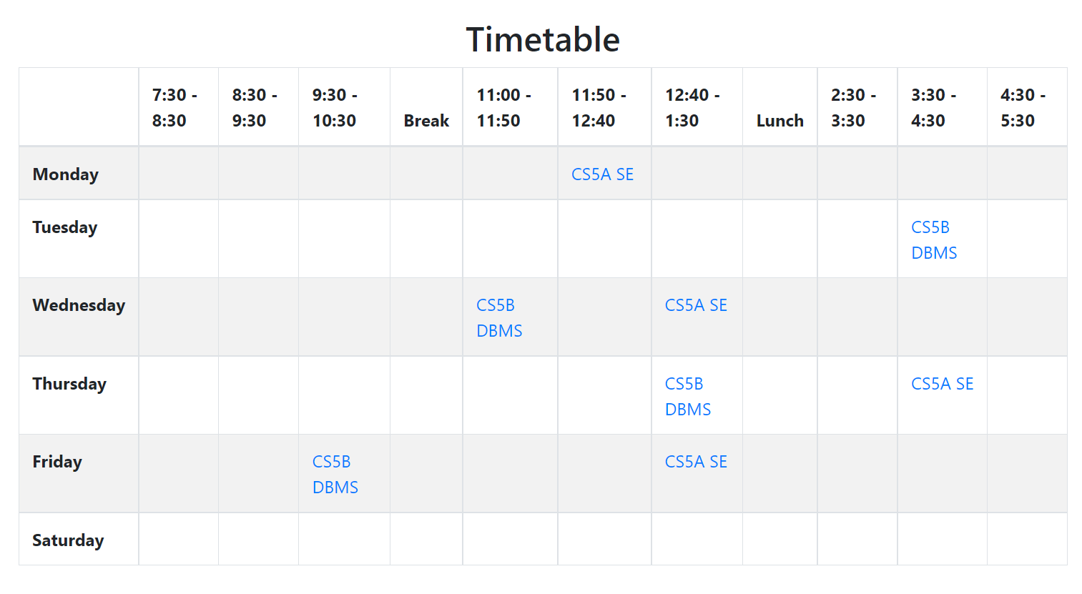
Time table

Slide 11
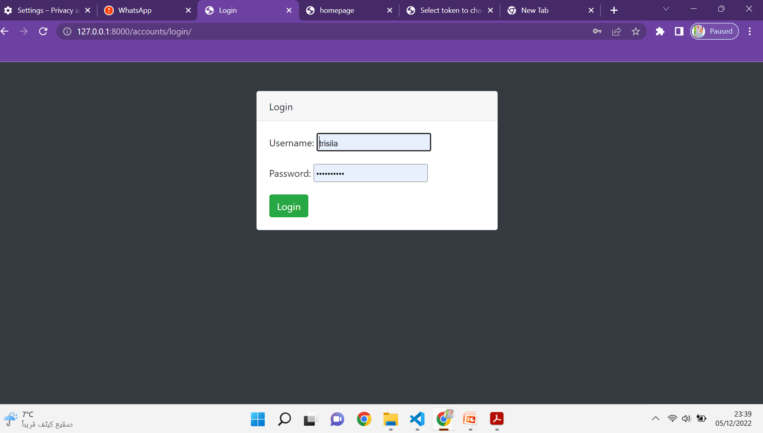
Teachers login page

Slide 12
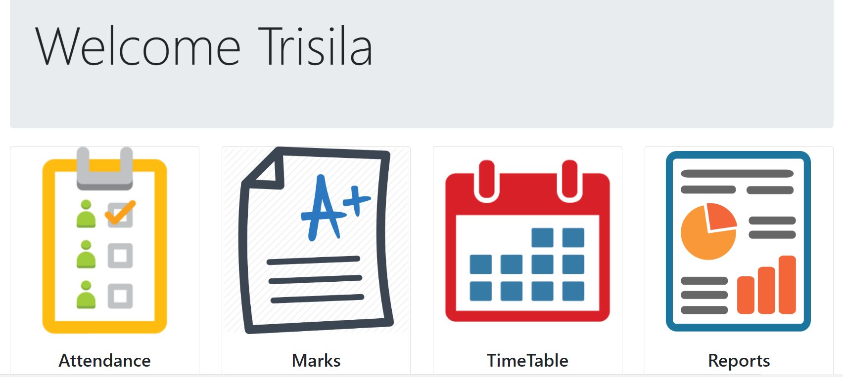
Homepage

Slide 13
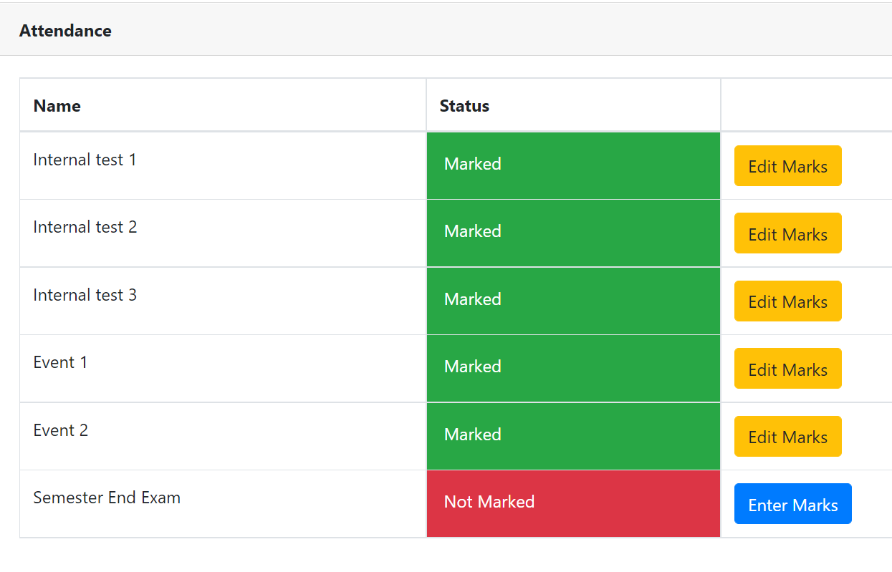
Attendance

Slide 14
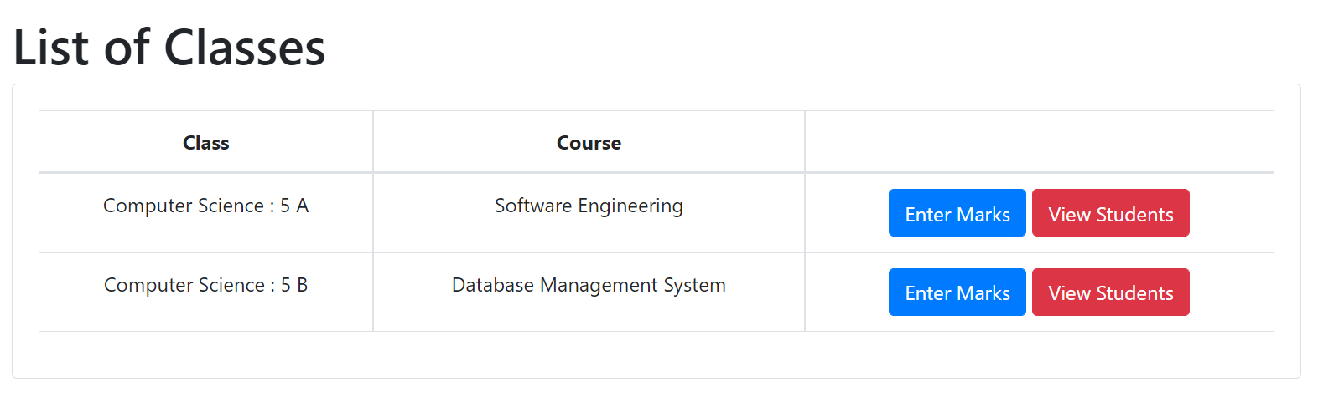
Marks

Slide 15
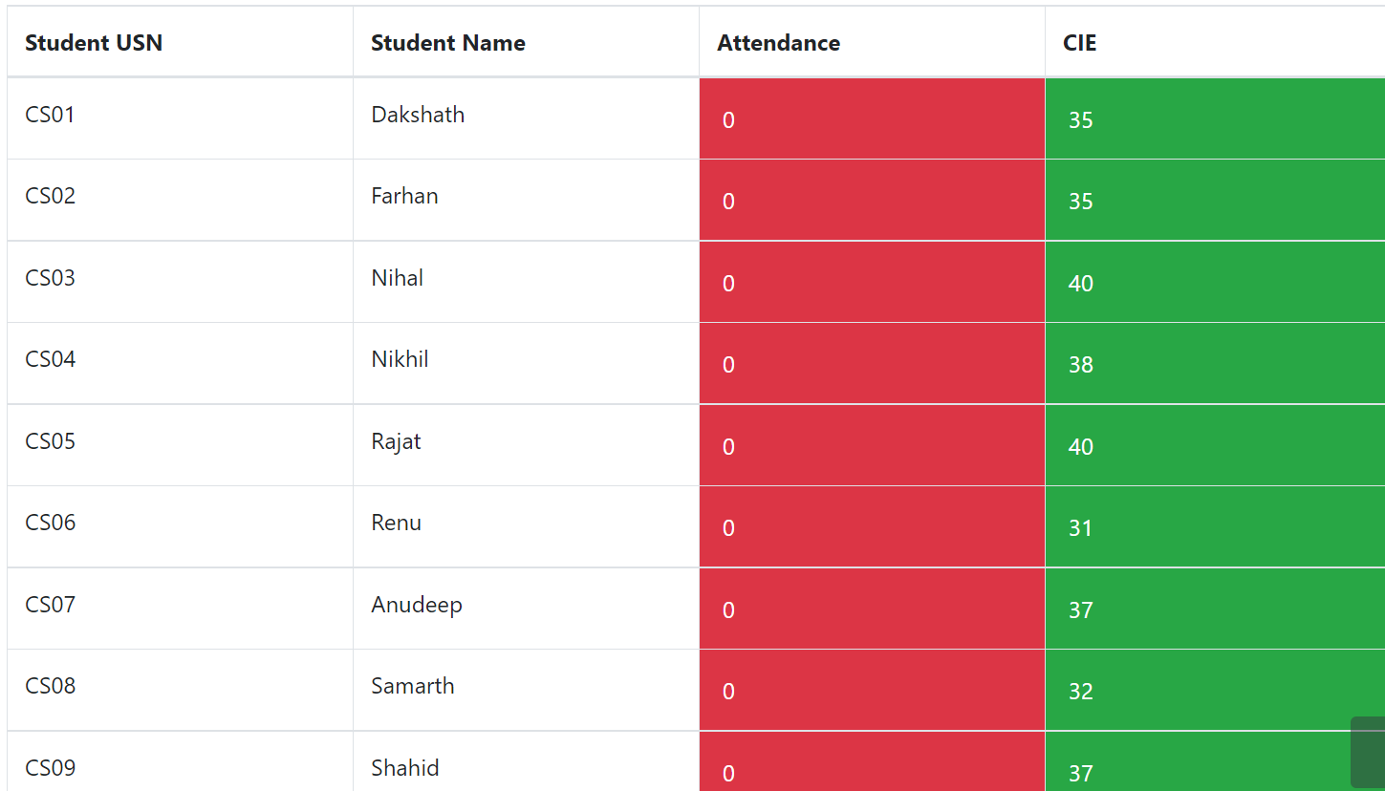
Reports

Slide 16
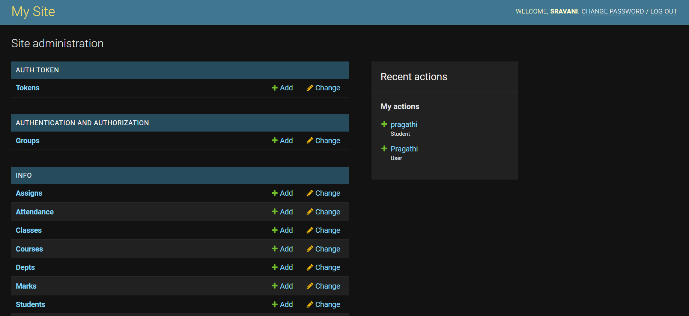
Administrator login Page

Slide 17
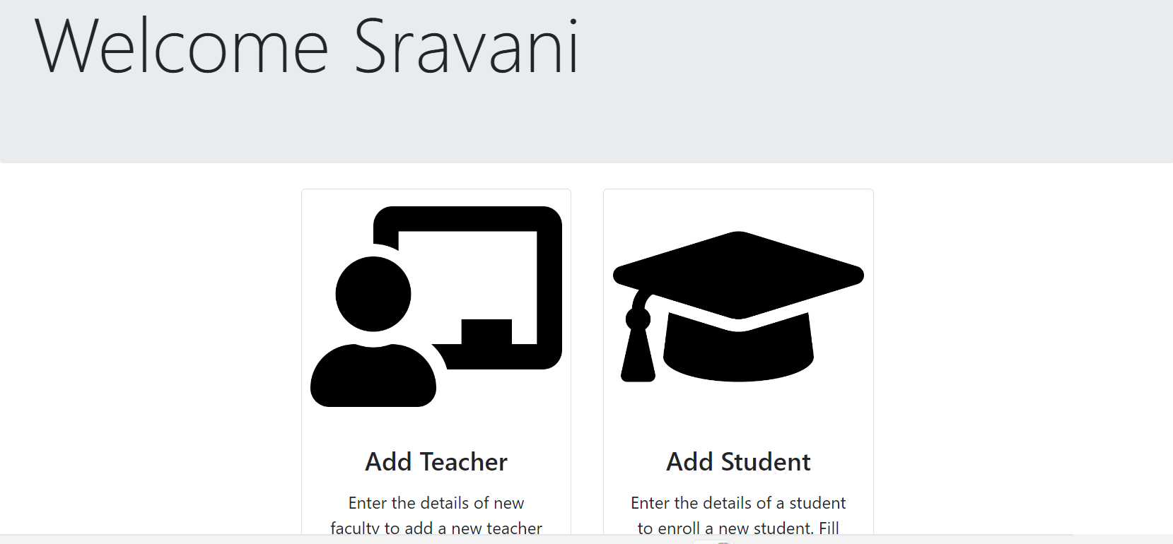
Administrator Homepage

Slide 18
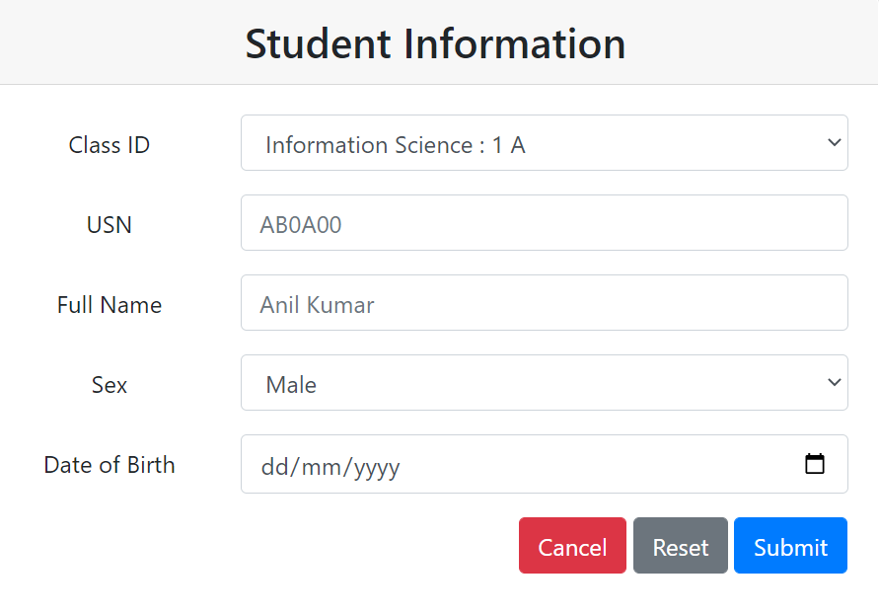

Slide 19
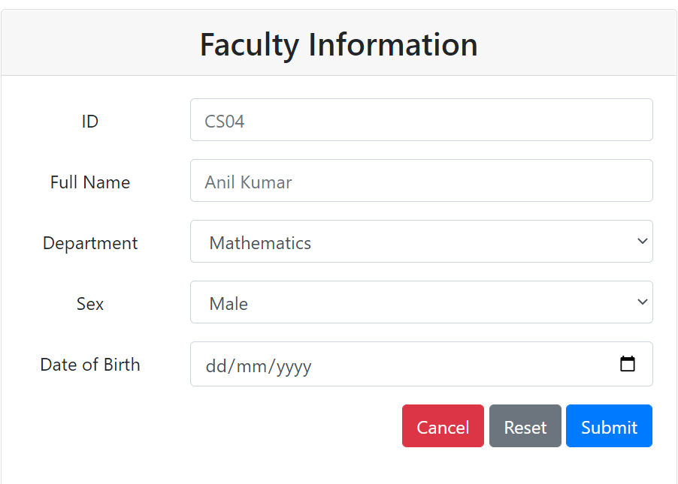

Slide 20
Human centre computing Interactions
Here we are using interactive elements by mouse clicks and how the interaction between system and users takes place is taken.
Various buttons are there and access is given accordingly with respect to type of users.
We have used python and html for building web page to create more interactively.

Slide 21
Thank you !

